Slide 1
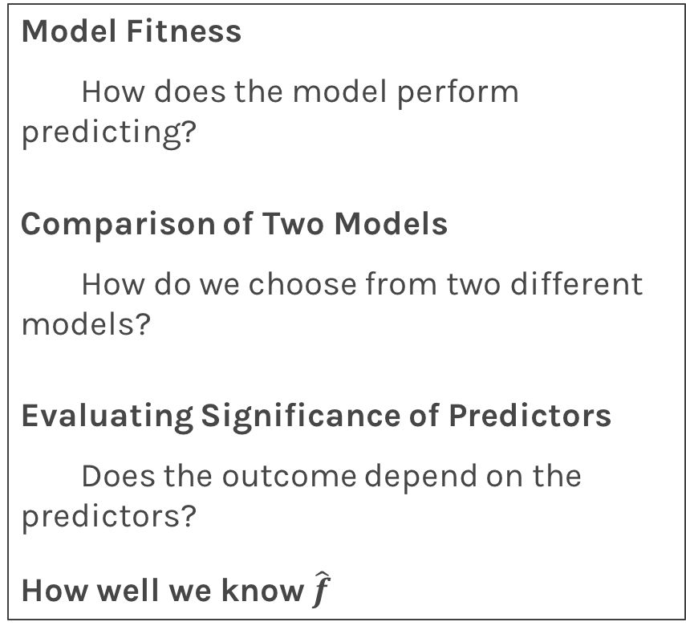
Lecture Outline
Data
Statistical Modeling I
k-Nearest Neighbors (kNN)
Statistical Modeling II
Linear Regression
Model Fitness
How does the model perform predicting?
Comparison of Two Models
How do we choose from two different models?
Evaluating Significance of Predictors
Does the outcome depend on the predictors?
How well we know $\hat{f}$
Bootstrap
Standard Errors
Hypothesis Testing
Confidence Intervals

Slide 2
Let’s start

Slide 3
Predicting a Variable
Let's image a scenario where we'd like to predict one variable using another (or a set of other) variables.
Examples:
Predicting the amount of views a YouTube video will get next week based on video length, the date it was posted, previous number of views, etc.
Predicting which movies a Netflix user will rate highly based on their previous movie ratings, demographic data etc.

Slide 4
Data

Slide 5
Data
The Advertising data set consists of the sales of that product in 200 different markets, along with advertising budgets for the product in each of those markets for three different media: TV, radio, and newspaper. Everything is given in units of $1000.
,
TV | radio | newspaper | sales
230.1 | 37.8 | 69.2 | 22.1
44.5 | 39.3 | 45.1 | 10.4
17.2 | 45.9 | 69.3 | 9.3
151.5 | 41.3 | 58.5 | 18.5
180.8 | 10.8 | 58.4 | 12.9
… | … | … | …
Some of the figures in this presentation are taken from "An Introduction to Statistical Learning, with applications in R" (Springer, 2013) with permission from the authors: G. James, D. Witten, T. Hastie and R. Tibshirani

Slide 6
Response vs. Predictor Variables
There is an asymmetry in many of these problems:
The variable we'd like to predict may be more difficult to measure, is more important than the other(s), or may be directly or indirectly influenced by the values of the other variable(s).
Thus, we'd like to define two categories of variables:
variables whose value we want to predict
variables whose values we use to make our prediction.

Slide 7
Response vs. Predictor Variables
X
predictors
features
covariates
Y
outcome
response variable
dependent variable
TV | radio | newspaper | sales
230.1 | 37.8 | 69.2 | 22.1
44.5 | 39.3 | 45.1 | 10.4
17.2 | 45.9 | 69.3 | 9.3
151.5 | 41.3 | 58.5 | 18.5
180.8 | 10.8 | 58.4 | 12.9
… | … | … | …
n observations
p predictors

Slide 8


Response vs. Predictor Variables
$$X=X_{1},…,X_{p}$$
$$X_{j}=x_{1j},…,x_{ij},…,x_{nj}$$
predictors
features
covariates
outcome
response variable
dependent variable
$$Y=y_{1},…,y_{n}$$
TV | radio | newspaper | sales
230.1 | 37.8 | 69.2 | 22.1
44.5 | 39.3 | 45.1 | 10.4
17.2 | 45.9 | 69.3 | 9.3
151.5 | 41.3 | 58.5 | 18.5
180.8 | 10.8 | 58.4 | 12.9
… | … | … | …
n observations
p predictors

Slide 9
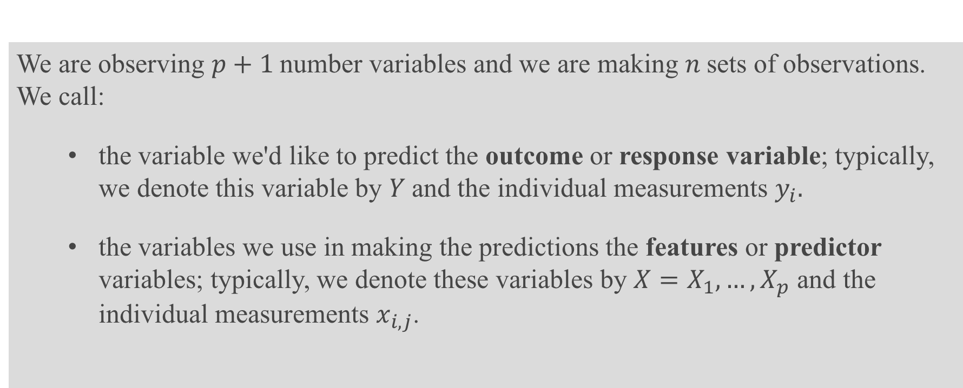
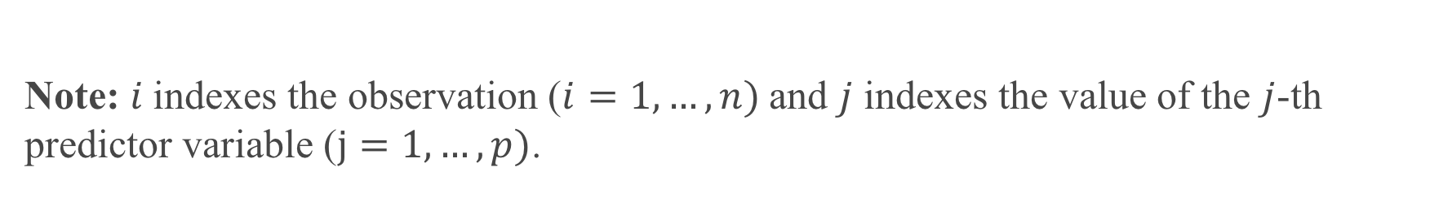
Definition
We are observing $p+1$number variables and we are making $n$sets of observations. We call:
the variable we'd like to predict the outcome or response variable; typically, we denote this variable by $Y$and the individual measurements $y_{i}.$
the variables we use in making the predictions the features or predictor variables; typically, we denote these variables by $X=X_{1},…,X_{p}$ and the individual measurements $x_{i,j}$.
Note: $i$indexes the observation ($i=1,…,n)$and $j$ indexes the value of the $j$-th predictor variable ($j=1,…,p)$.

Slide 10
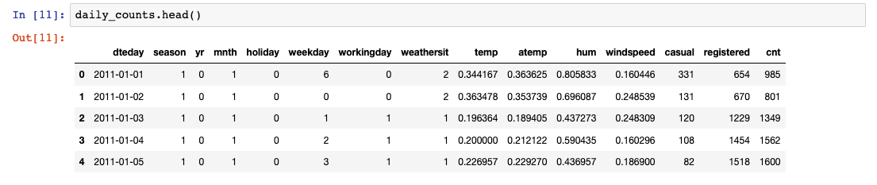
Exercise: Which columns are predictors? Respones?

Slide 11
Statistical Model

Slide 12
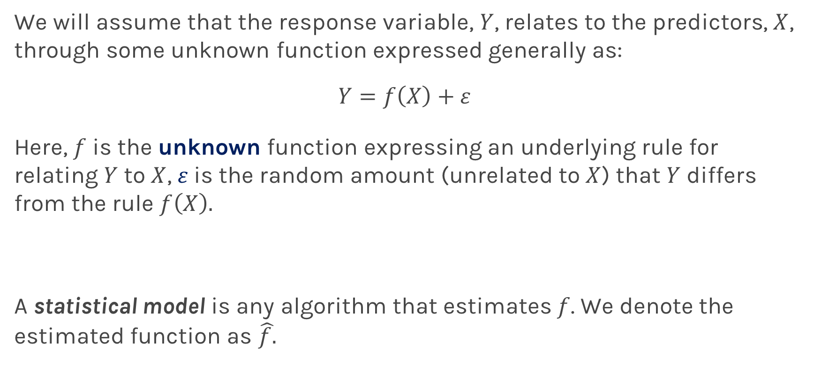
True vs. Statistical Model
We will assume that the response variable, $Y$, relates to the predictors, $X$, through some unknown function expressed generally as:
$$Y=f\left(X\right)+ε$$
Here, $f$ is the unknown function expressing an underlying rule for relating $Y$ to $X$, $ε$is the random amount (unrelated to $X$) that $Y$ differs from the rule $f\left(X\right).$
A statistical model is any algorithm that estimates $f$. We denote the estimated function as $\hat{f.}$

Slide 13
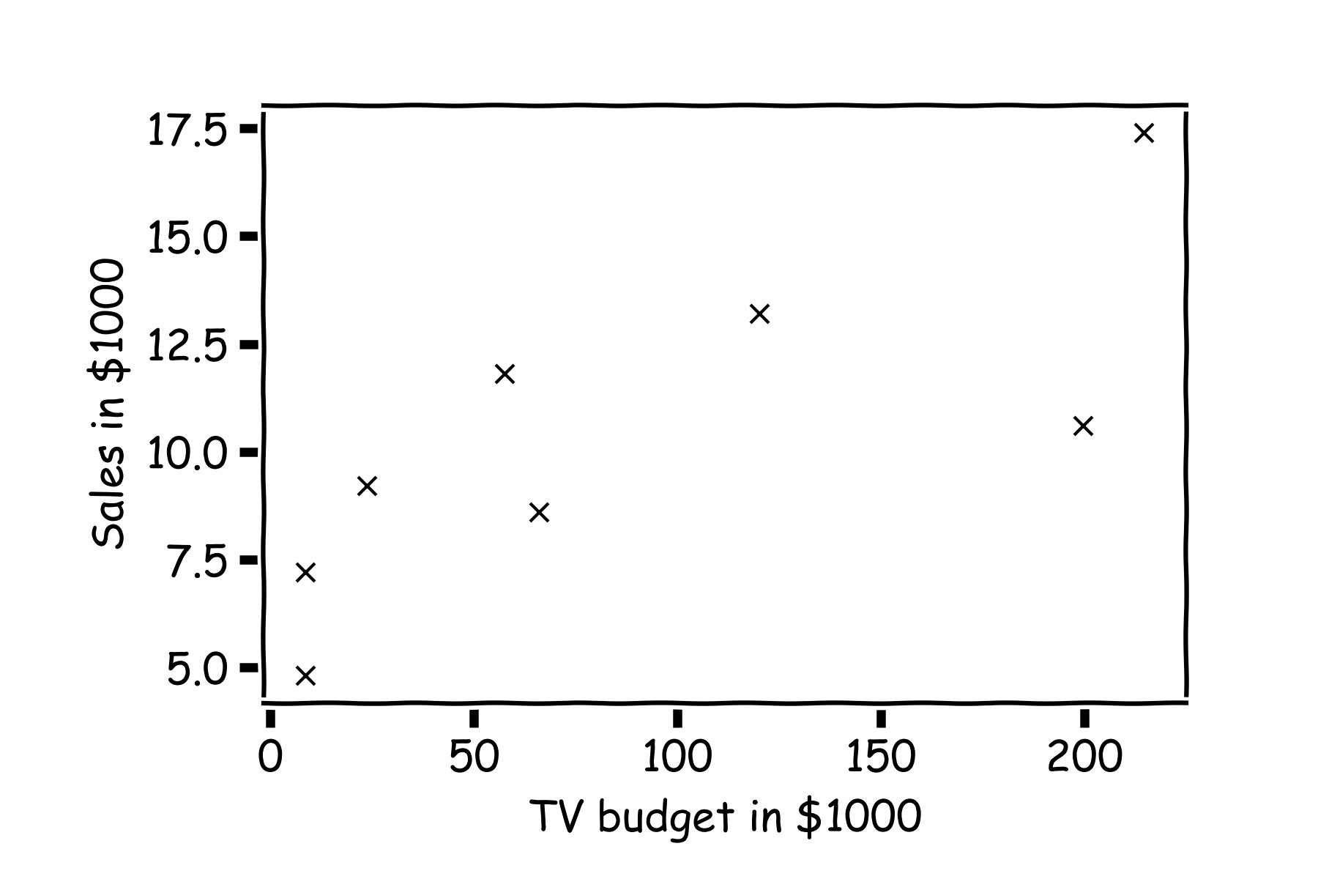
Statistical Model
y
x

Slide 14

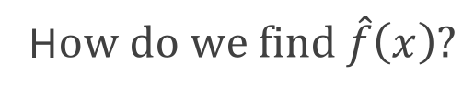
Statistical Model
H$ow do we find \hat{f}\left(x\right)?$
What is the value of y at this $x$?

Slide 15
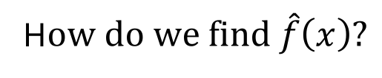
Statistical Model
H$ow do we find \hat{f}\left(x\right)?$
or here?

Slide 16
Statistical Model
Simple idea is to take the mean of all y’s, $\hat{f}\left(x\right)=\frac{1}{n}\sum_{1}^{n}{y_{i}}$

Slide 17
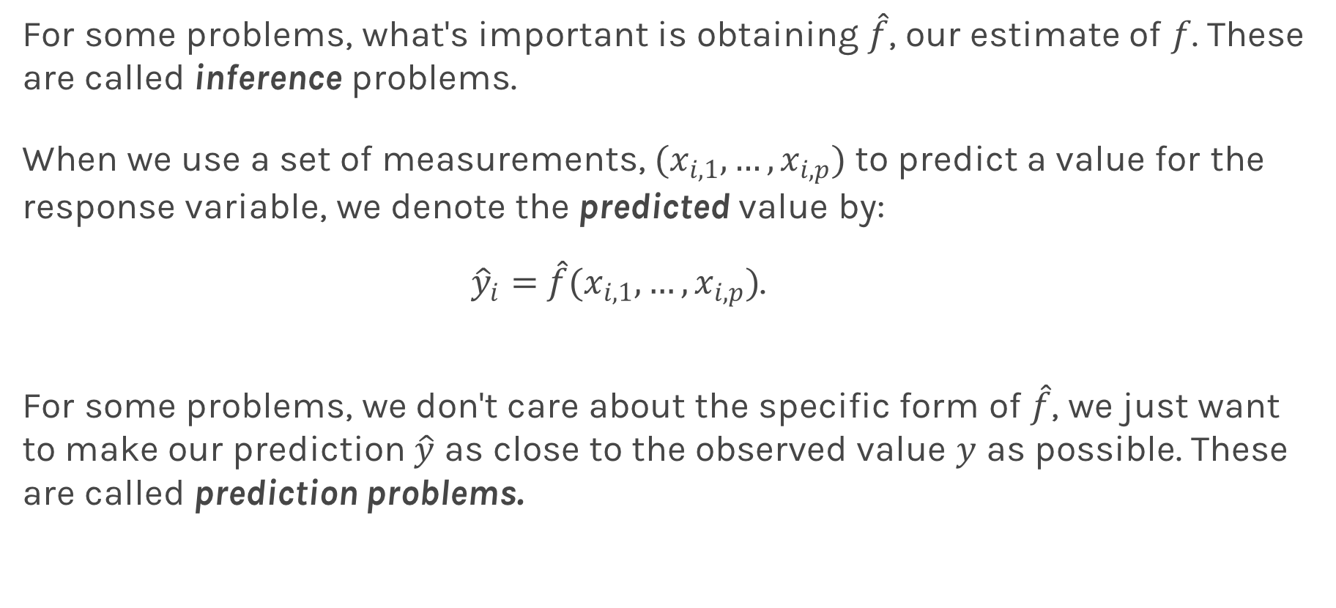
Prediction vs. Inference
For some problems, what's important is obtaining $\hat{f}$, our estimate of $f$. These are called inference problems.
When we use a set of measurements, $(x_{i,1}, …,x_{i,p})$ to predict a value for the response variable, we denote the predicted value by:
${\hat{y}}_{i}=$ $\hat{f}(x_{i,1}, …,x_{i,p})$.
For some problems, we don't care about the specific form of $\hat{f}$, we just want to make our prediction $\hat{y}$ as close to the observed value $y$ as possible. These are called prediction problems.

Slide 18
Examples of Prediction vs Inference Problems

Slide 19







Simple Prediction Model: Nearest Neighbor
What is ${\hat{y}}_{q}$at some $x_{q }$?
Find distances to all other points $D(x_{q},x_{i})$
$${(x}_{p},y_{p})$$
$${\hat{y}}_{q}$$
Find the nearest neighbor, ${(x}_{p},y_{p})$
Predict ${\hat{y}}_{q}=y_{p}$
$$x_{q}$$
Notes:
Is it clear that x_q is really x_i,q? (DLS)

Slide 20
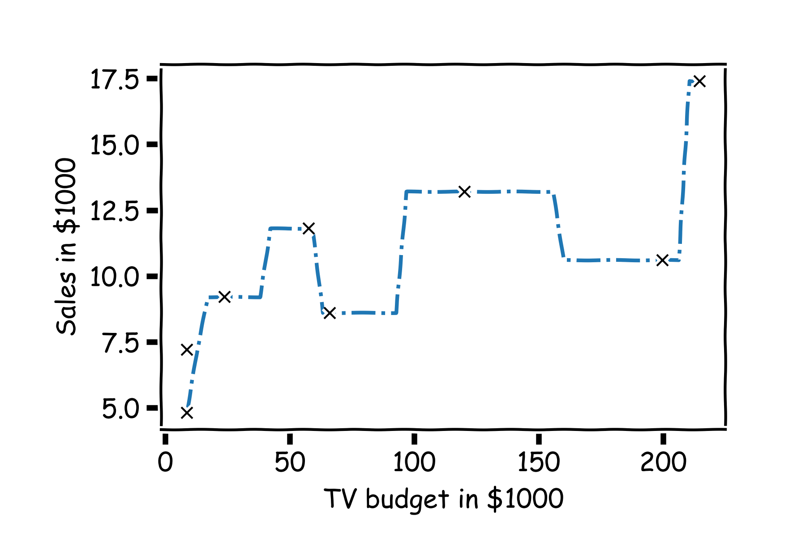
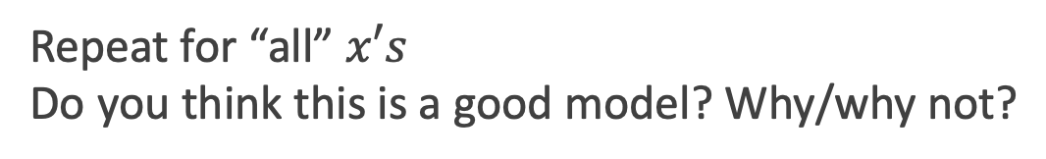
Simple Prediction Model
Repeat for “all” $x′s$
Do you think this is a good model? Why/why not?

Slide 21



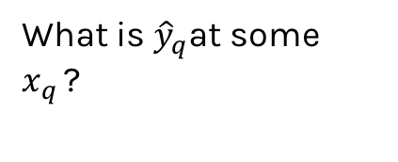

Extend the Prediction Model: Nearest neighbors
What is ${\hat{y}}_{q}$at some $x_{q }$?
Find distances to all other points $D(x_{q},x_{i})$
$${\hat{y}}_{q}$$
Find the k-nearest neighbors, $x_{q_{1}},…,x_{q_{k}}$
Predict $\hat{y_{q }}=\frac{1}{k}\sum_{i}^{k}{y_{q_{i}}}$
$$x_{q}$$
Notes:
Change indeces and show k-nearest

Slide 22
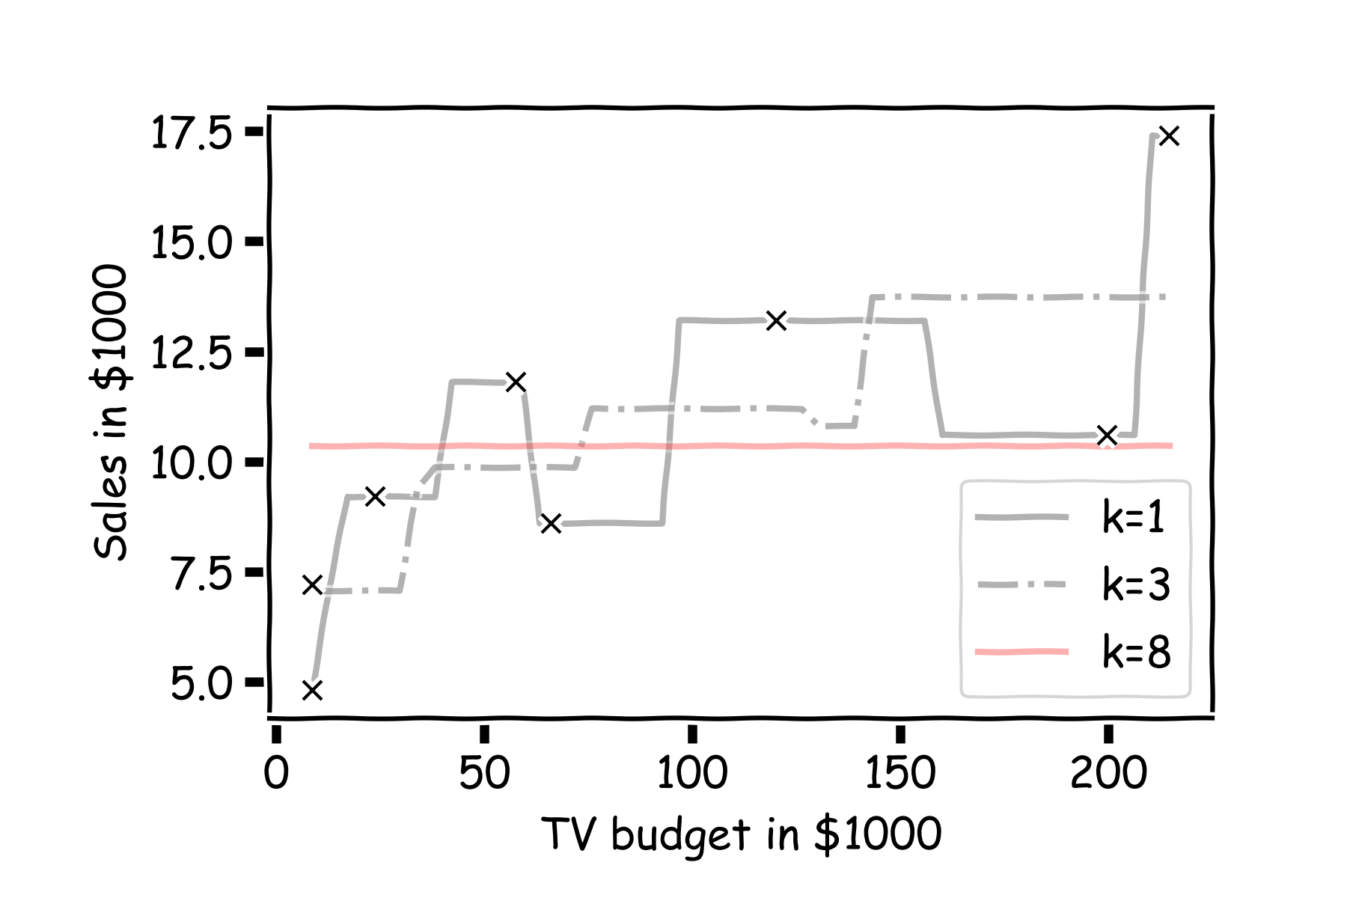
What happens to the predictions as k gets bigger? Why?
Notes:
Change indeces and show k-nearest

Slide 23
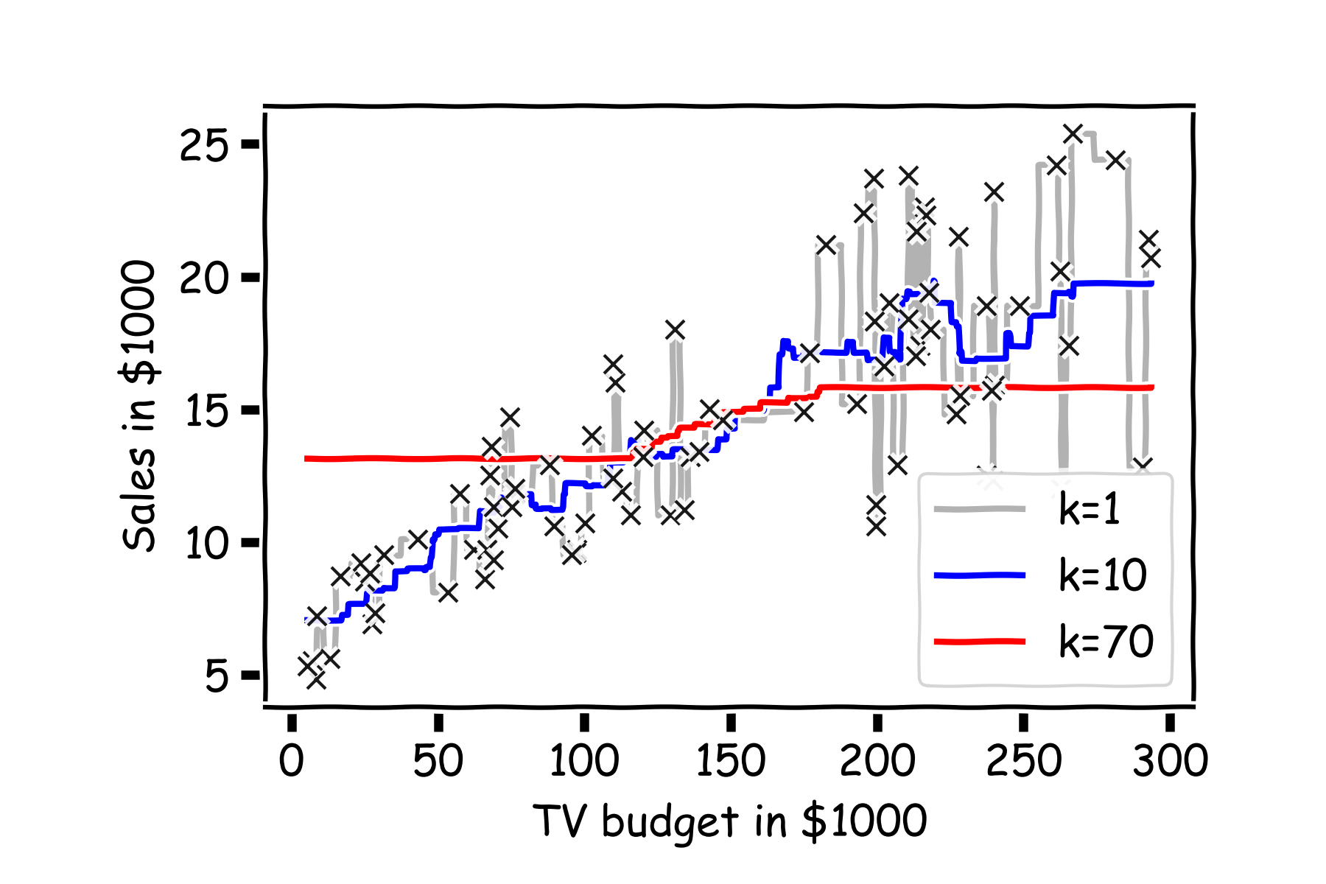
Simple Prediction Models
Same models on more data. What do you notice?
Notes:
Change indeces and show k-nearest

Slide 24
k-Nearest Neighbors
The k-Nearest Neighbor (kNN) model is an intuitive way to predict a quantitative response variable:
to predict a response for a set of observed predictor values, we use the responses of other observations most similar to it
Note: this strategy can also be applied in classification to predict a categorical variable. We will encounter kNN again later in the course in the context of classification.
Notes:
Change indeces and show k-nearest

Slide 25

k-Nearest Neighbors - kNN
For a fixed a value of k, the predicted response for the $i$-th observation is the average of the observed response of the k-closest observations:
where $\left\{x_{n1},…,x_{nk}\right\}$ are the k observations most similar to $x_{i}$ (similar refers to a notion of distance between predictors).
Notes:
Notice y_hat instead of f_hat
I think the index on y_hat is wrong but I can’t change it b/c it’s an image. (DLS)

Slide 26
CAUTION: Data Scientists Are Bad At Naming Things
Don’t confuse this with “k-means clustering”.
(k) Nearest Neighbors: predict a single sample’s label based on label of nearest neighbors. Needs labels (“Supervised”)
K-means clustering: predict how samples are grouped based on patterns of proximity. No labels (“unsupervised”)
We’ll see k-means clustering later.

Slide 27
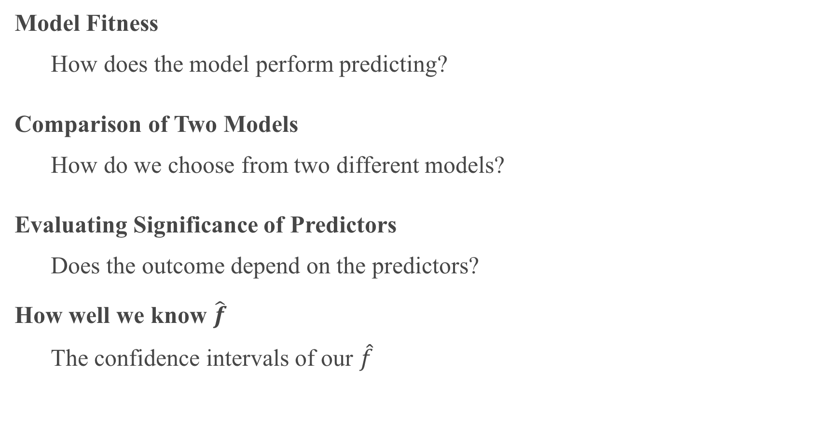
Things to Consider
Model Fitness
How does the model perform predicting?
Comparison of Two Models
How do we choose from two different models?
Evaluating Significance of Predictors
Does the outcome depend on the predictors?
How well we know $\hat{f}$
The confidence intervals of our $\hat{f}$

Slide 28
Error Evaluation

Slide 29
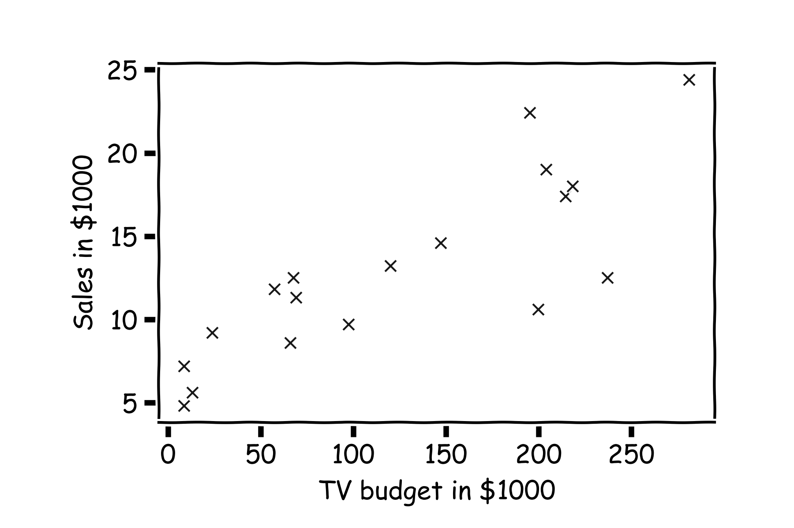
Error Evaluation
Start with some data.
Notes:
Change indeces and show k-nearest

Slide 30
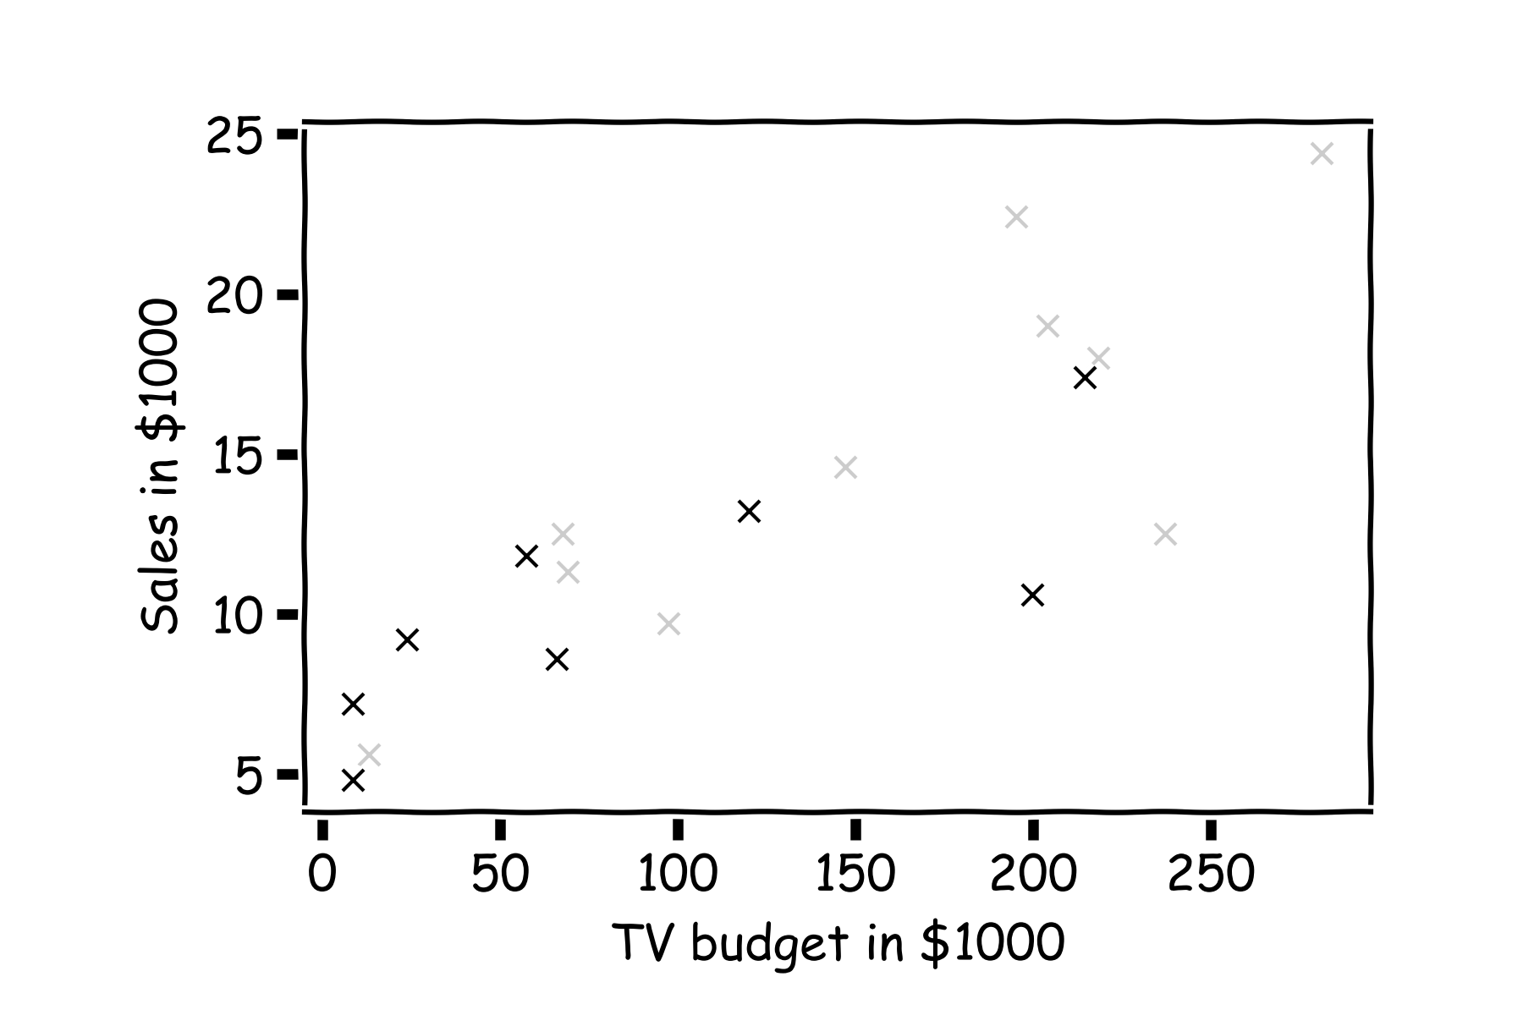
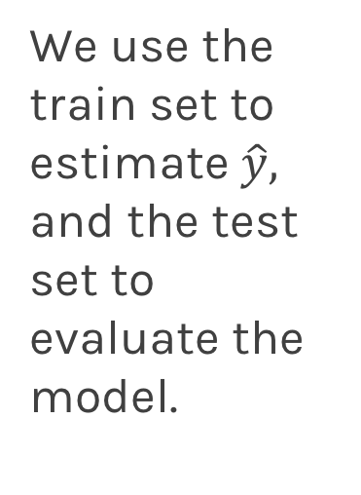
Error Evaluation
Hide some of the data from the model. This is called train-test split.
We use the train set to estimate $\hat{y},$ and the test set to evaluate the model.

Slide 31
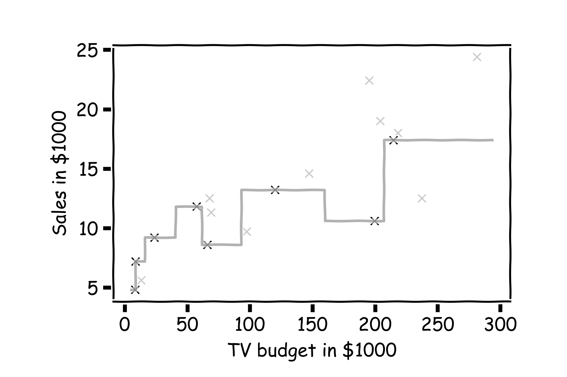
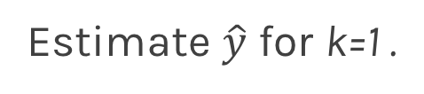
Error Evaluation
Estimate $\hat{y}$ for k=1 .
Notes:
Change indeces and show k-nearest

Slide 32
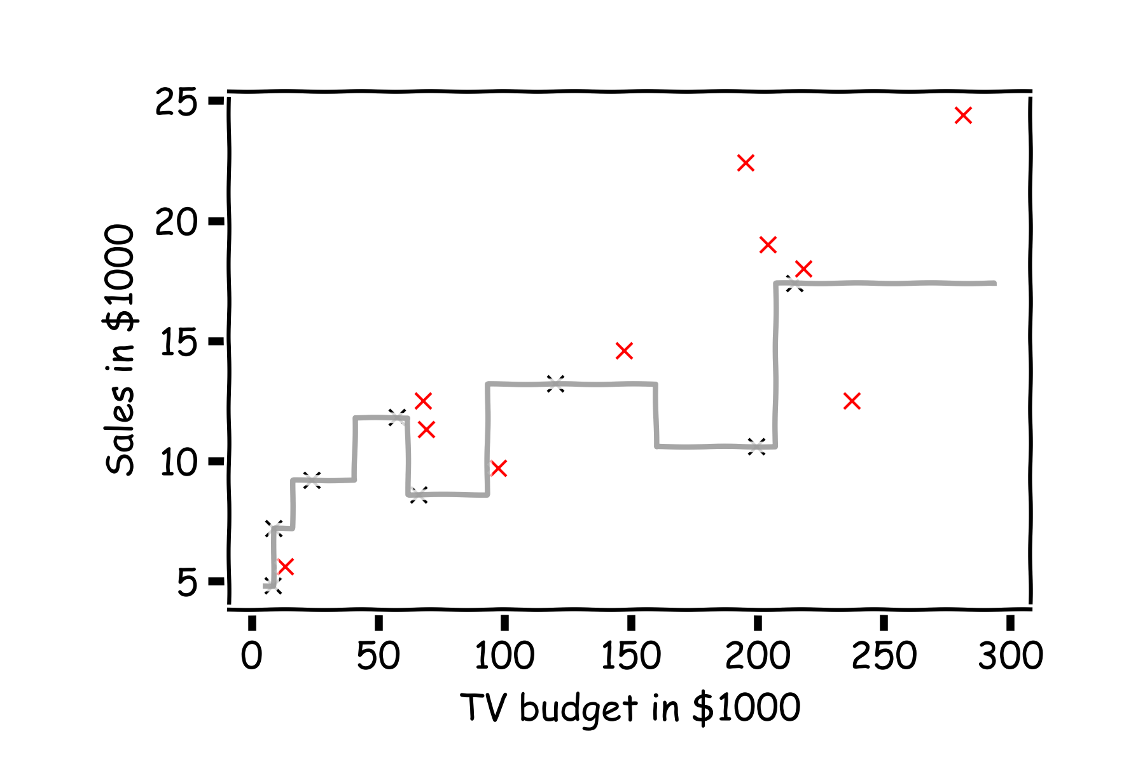
Error Evaluation
Now, we look at the data we have not used, the test data (red crosses).

Slide 33
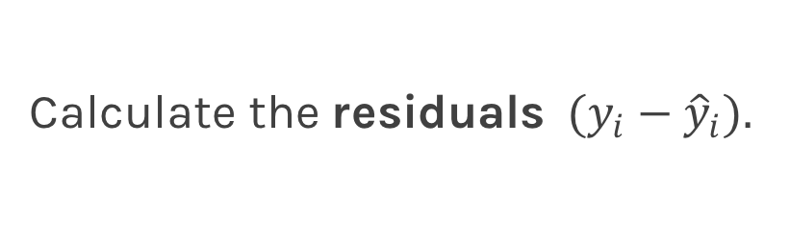
Error Evaluation
Calculate the ${\text{residuals} (y}_{i}−{\hat{y}}_{i}).$
Notes:
Change indeces and show k-nearest

Slide 34
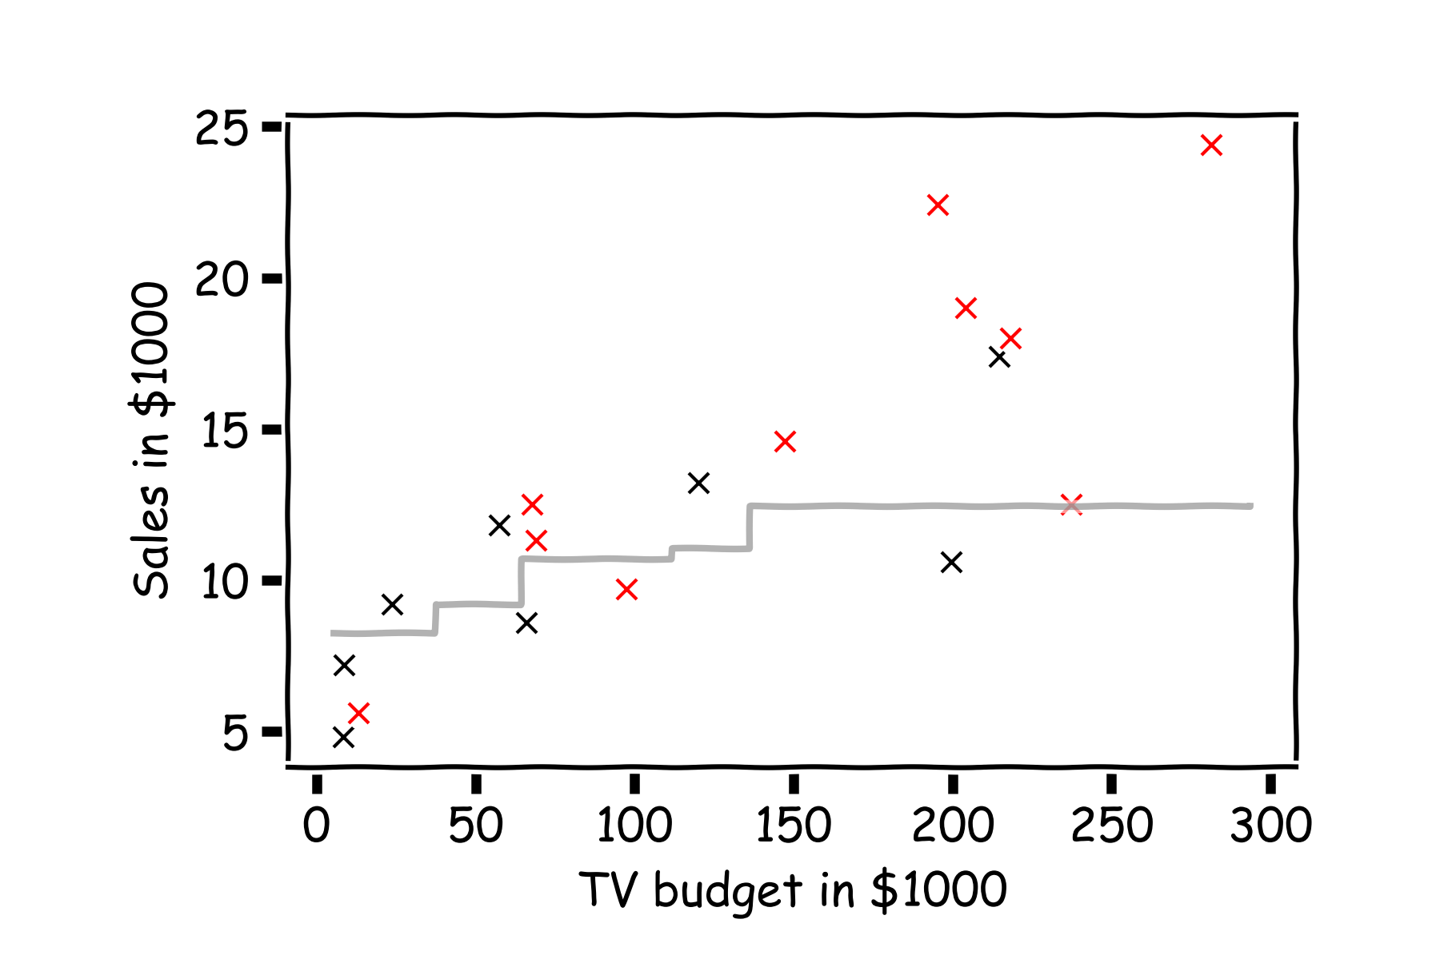
Error Evaluation
Do the same for k=3.

Slide 35
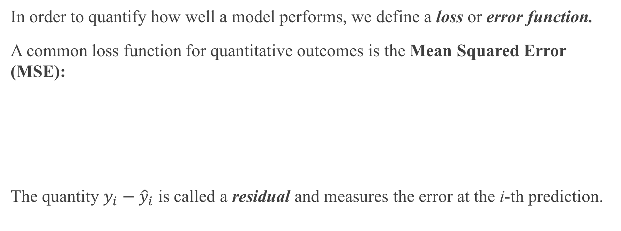
Error Evaluation
In order to quantify how well a model performs, we define a loss or error function.
A common loss function for quantitative outcomes is the Mean Squared Error (MSE):
The quantity $y_{i}−{\hat{y}}_{i}$ is called a residual and measures the error at the i-th prediction.

Slide 36
Error Evaluation
Caution: The MSE is by no means the only valid (or the best) loss function!
Question: What would be an intuitive loss function for predicting categorical outcomes?
Note: The square Root of the Mean of the Squared Errors (RMSE) is also commonly used. (Why? Think about units…)

Slide 37
Why did we split the data?
Could we have evaluated the error on the training data (grey crosses)?

Slide 38
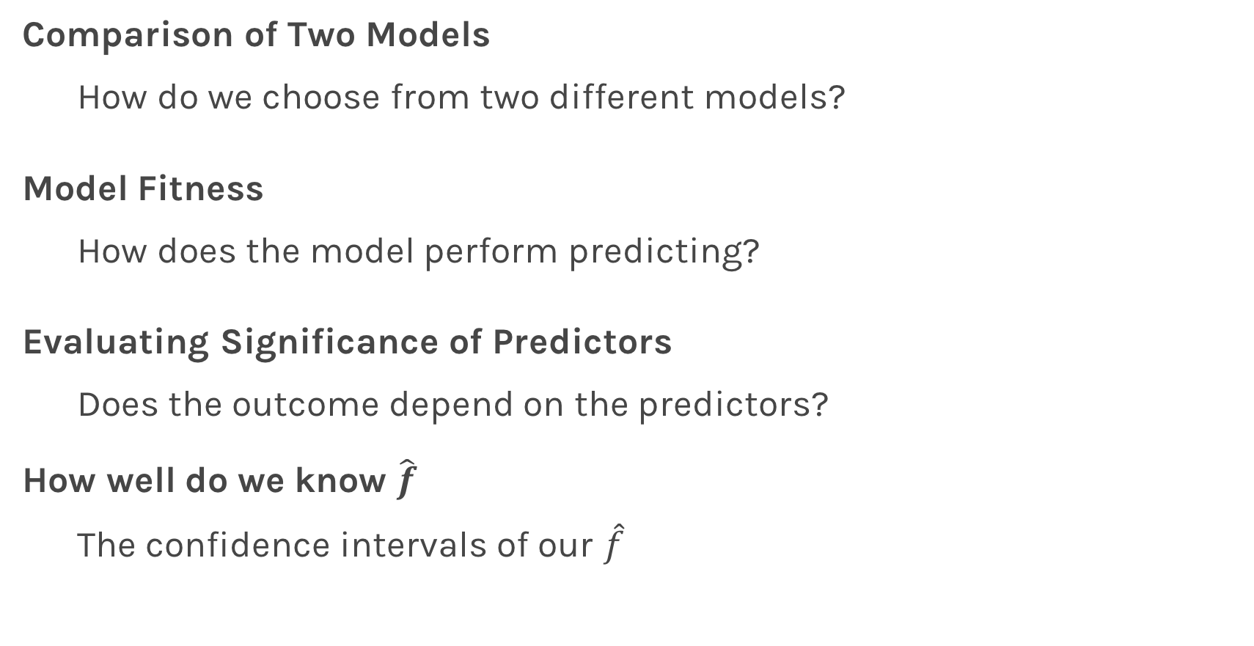
Things to Consider
Comparison of Two Models
How do we choose from two different models?
Model Fitness
How does the model perform predicting?
Evaluating Significance of Predictors
Does the outcome depend on the predictors?
How well do we know $\hat{f}$
The confidence intervals of our $\hat{f}$

Slide 39
Model Comparison

Slide 40
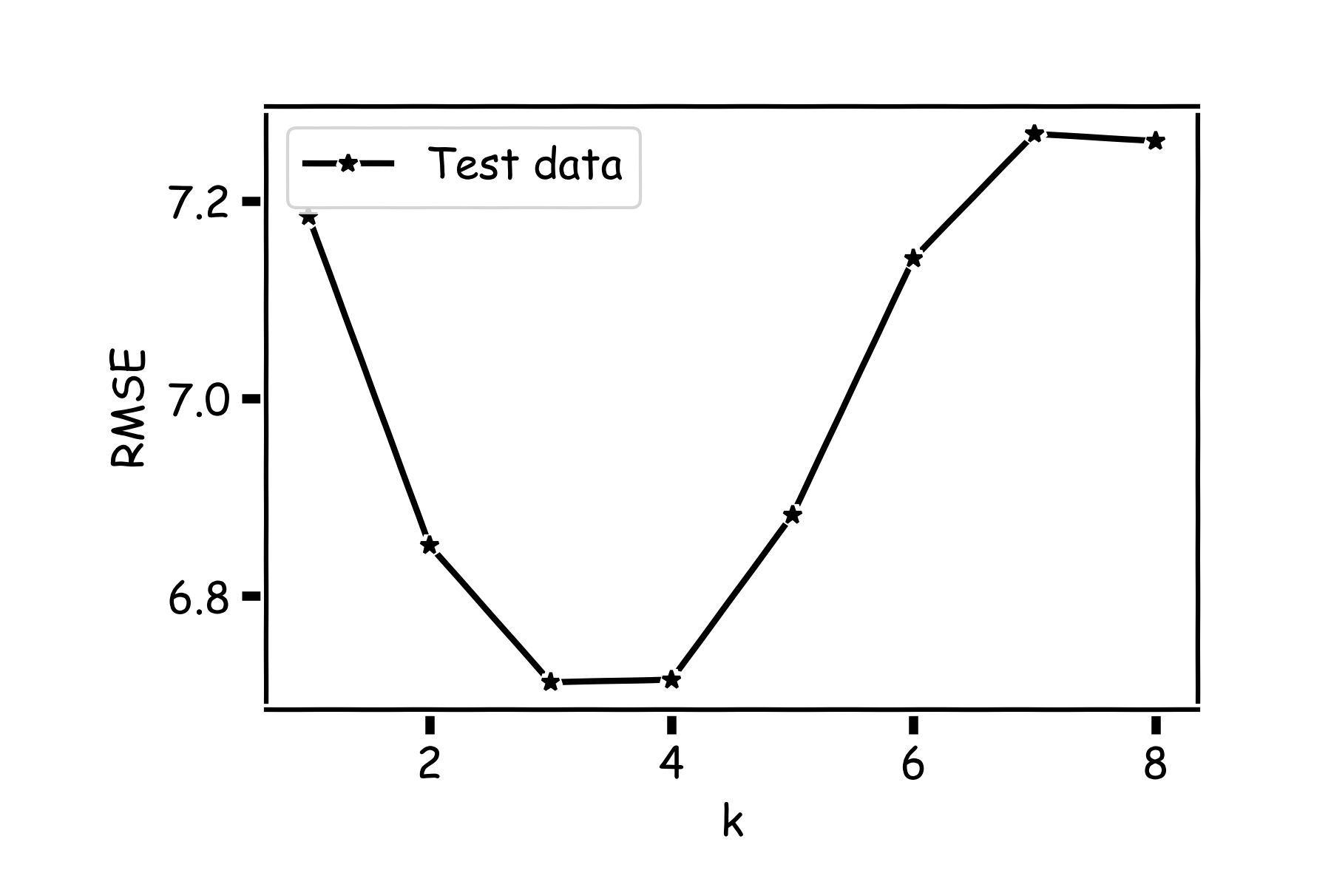
Model Comparison
Do the same for all k’s and compare the RMSEs on test data. Which k is best?

Slide 41
Things to Consider
Comparison of Two Models
How do we choose from two different models?
Model Fitness
How does the model perform predicting?
Evaluating Significance of Predictors
Does the outcome depend on the predictors?
How well do we know $\hat{f}$
The confidence intervals of our $\hat{f}$

Slide 42
Model Fitness

Slide 43
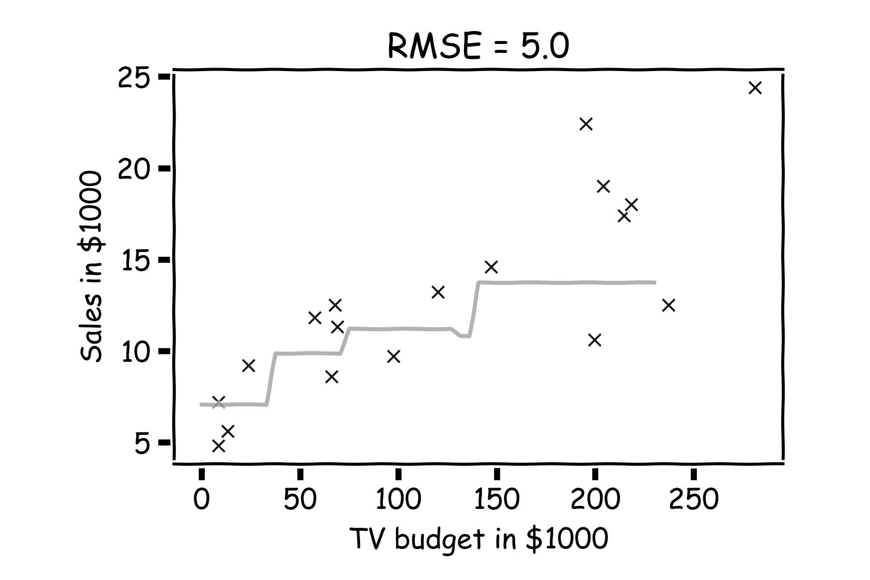
Model fitness
For a subset of the data, calculate the RMSE for k=3. Is RMSE=5.0 good enough?

Slide 44
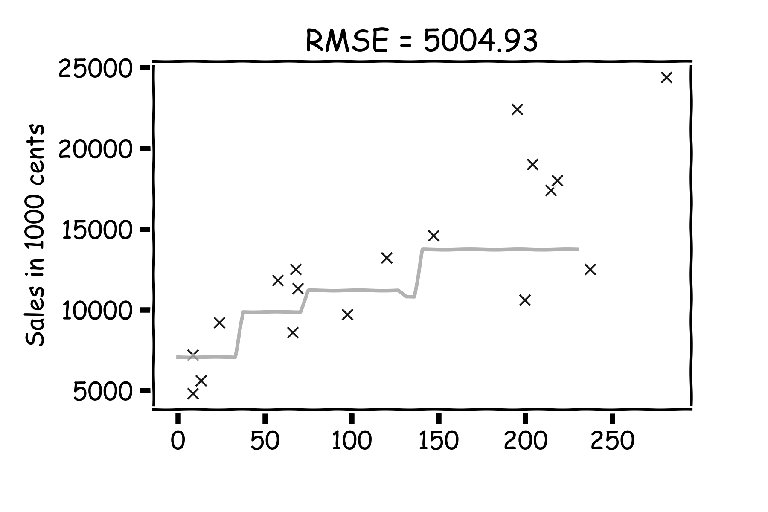
Model fitness
What if we measure the Sales in dollars instead of thousands of dollars?
RMSE is now 5004.93.
Is that good?

Slide 45
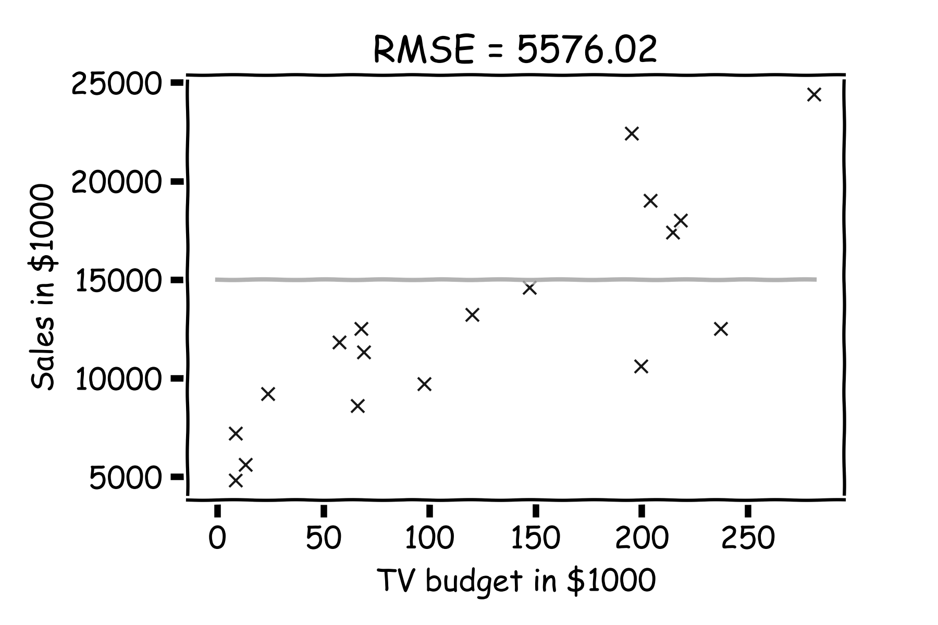
Model fitness
It is better if we compare it to something.
We will use the simplest model:

Slide 46
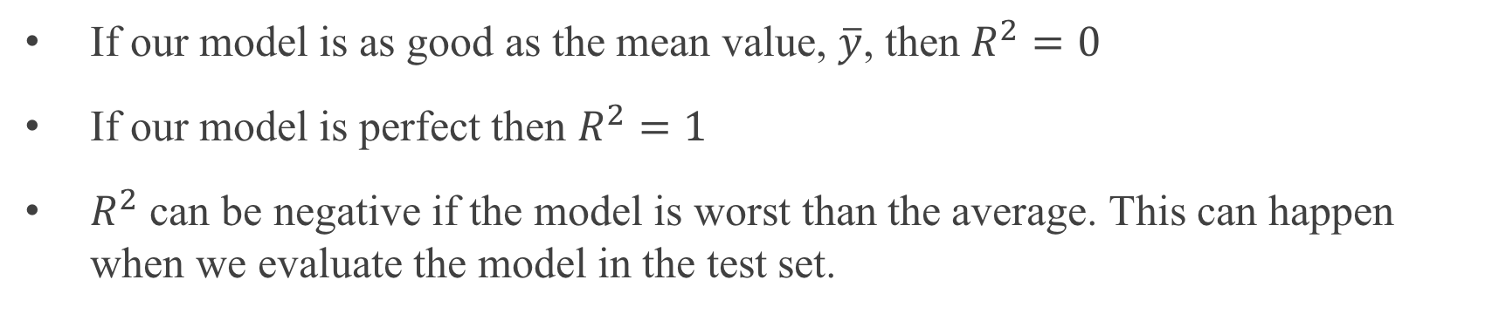
R-squared
If our model is as good as the mean value, $\overline{y}$, then $R^{2}=0$
If our model is perfect then $R^{2}=1$
$R^{2}$ can be negative if the model is worst than the average. This can happen when we evaluate the model in the test set.
Notes:
Change this to a nicer plot

Slide 47
Linear Regression

Slide 48
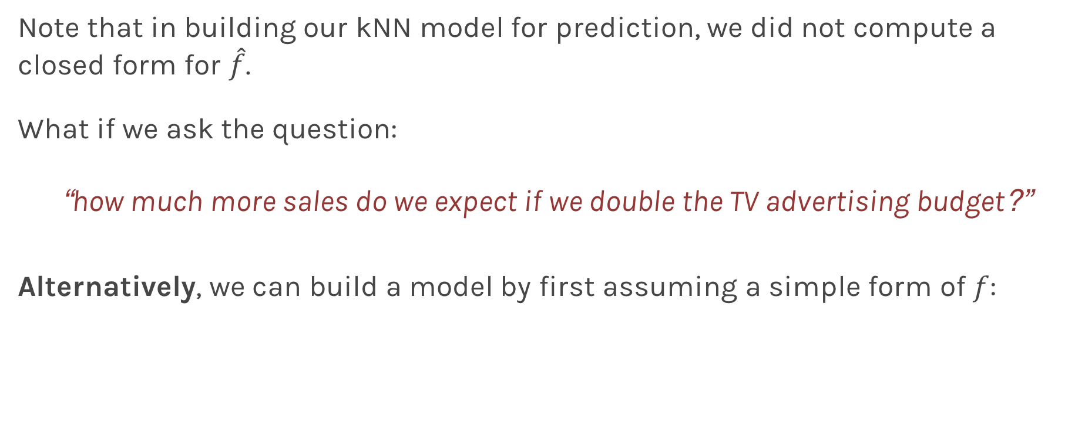
Linear Models
Note that in building our kNN model for prediction, we did not compute a closed form for $\hat{f}$.
What if we ask the question:
“how much more sales do we expect if we double the TV advertising budget?”
Alternatively, we can build a model by first assuming a simple form of $f$:

Slide 49

Linear Regression
If our statistical model is:
then it follows that our estimate is:
where ${\hat{β}}_{1}$ and ${\hat{β}}_{0}$are estimates of $β_{1}$ and $β_{0}$ respectively, that we compute using observations.

Slide 50
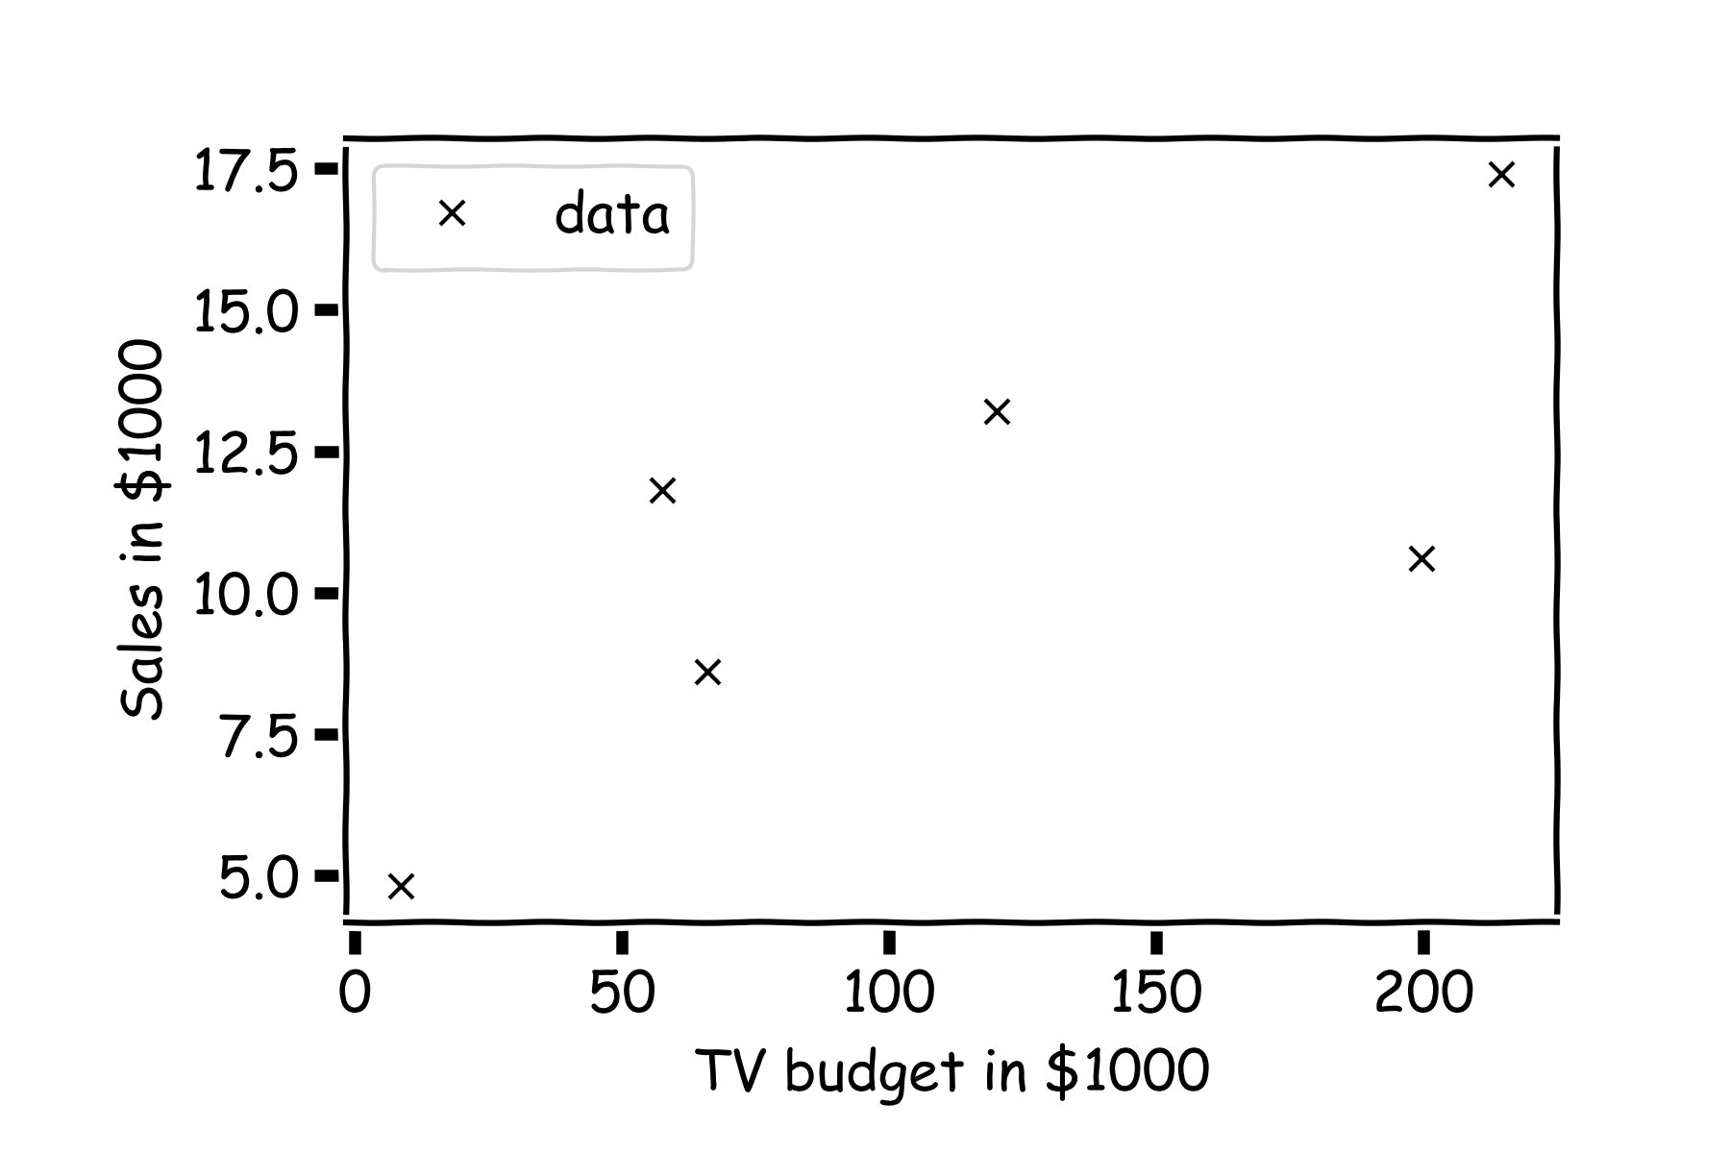
Linear Regression
For a given data set

Slide 51
Linear Regression
Is this line good?

Slide 52
Linear Regression
Maybe this one?

Slide 53
Linear Regression
Or this?

Slide 54

Inference for Linear Regression
We choose ${\hat{β}}_{1}$and ${\hat{β}}_{0}$ in order to minimize the predictive errors made by our model, i.e. minimize our loss function.
Again we use MSE as our loss function,
Then the optimal values for ${\hat{β}}_{0}$ and ${\hat{β}}_{1}$ should be:

Slide 55
Inference for Linear Regression
First calculate the residuals

Slide 56
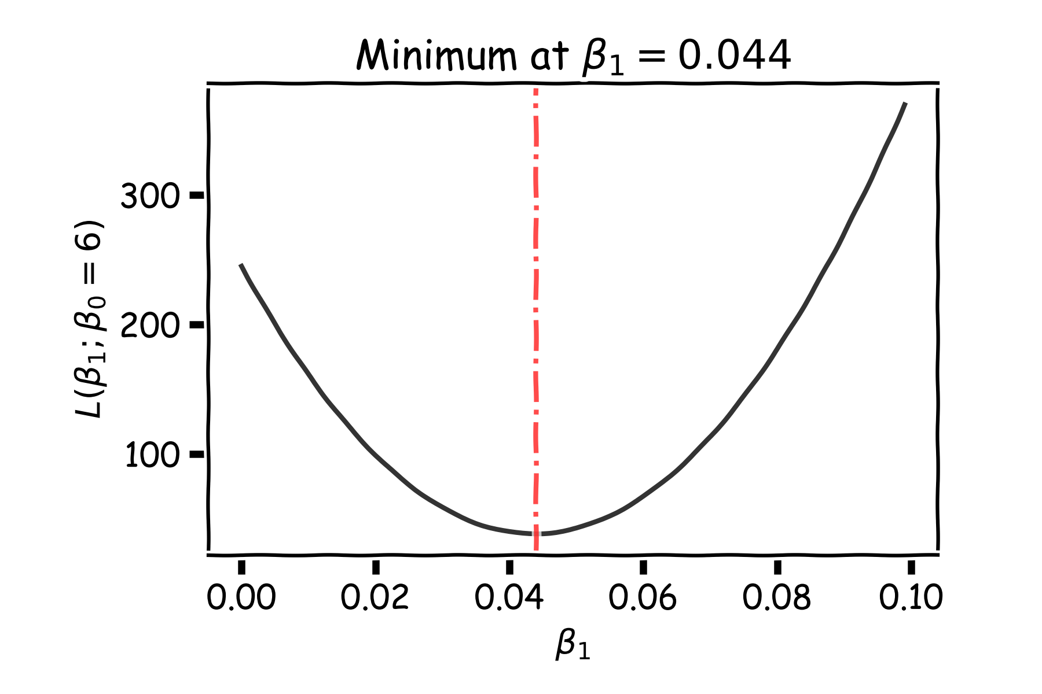
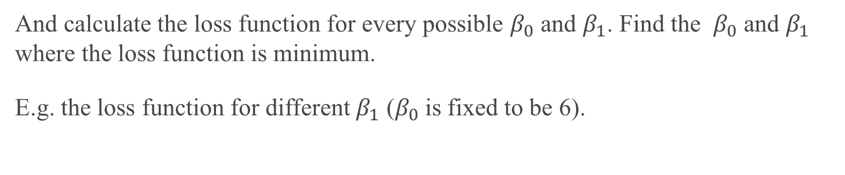
Linear Regression
And calculate the loss function for every possible $β_{0}$ and $β_{1}$. Find the $β_{0}$ and $β_{1}$ where the loss function is minimum.
E.g. the loss function for different $β_{1}$ ($β_{0}$is fixed to be 6).
Notes:
Should you mention that this would be a ``numerical’’ approach?

Slide 57
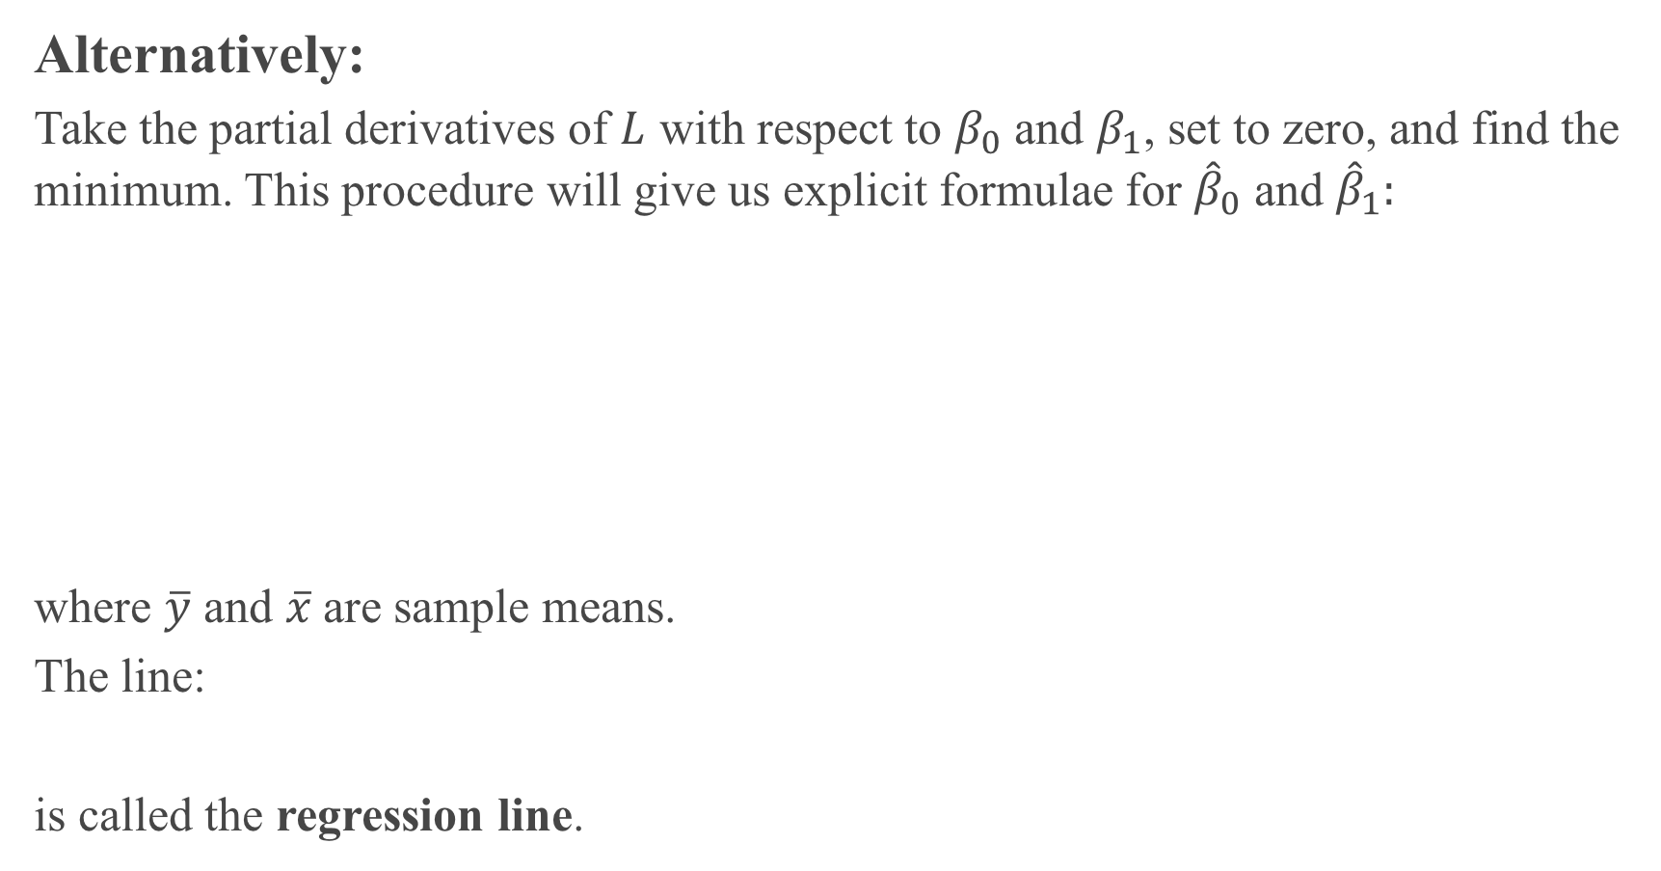
Alternatively:
Take the partial derivatives of $L$ with respect to $β_{0}$ and $β_{1}$, set to zero, and find the minimum. This procedure will give us explicit formulae for ${\hat{β}}_{0}$ and ${\hat{β}}_{1}:$
where $\overline{y}$ and $\overline{x}$are sample means.
The line:
is called the regression line.
Notes:
Should you mention that this is the analytical approach? (DLS)

Slide 58
More on Loss Function
There are multiple ways to measure the fitness of a model, i.e. there are multiple loss functions.
Max absolute deviation: Count only the biggest error
Sum of absolute deviations: Add up the error
Sum of squared errors: Add up the squared error

Slide 59
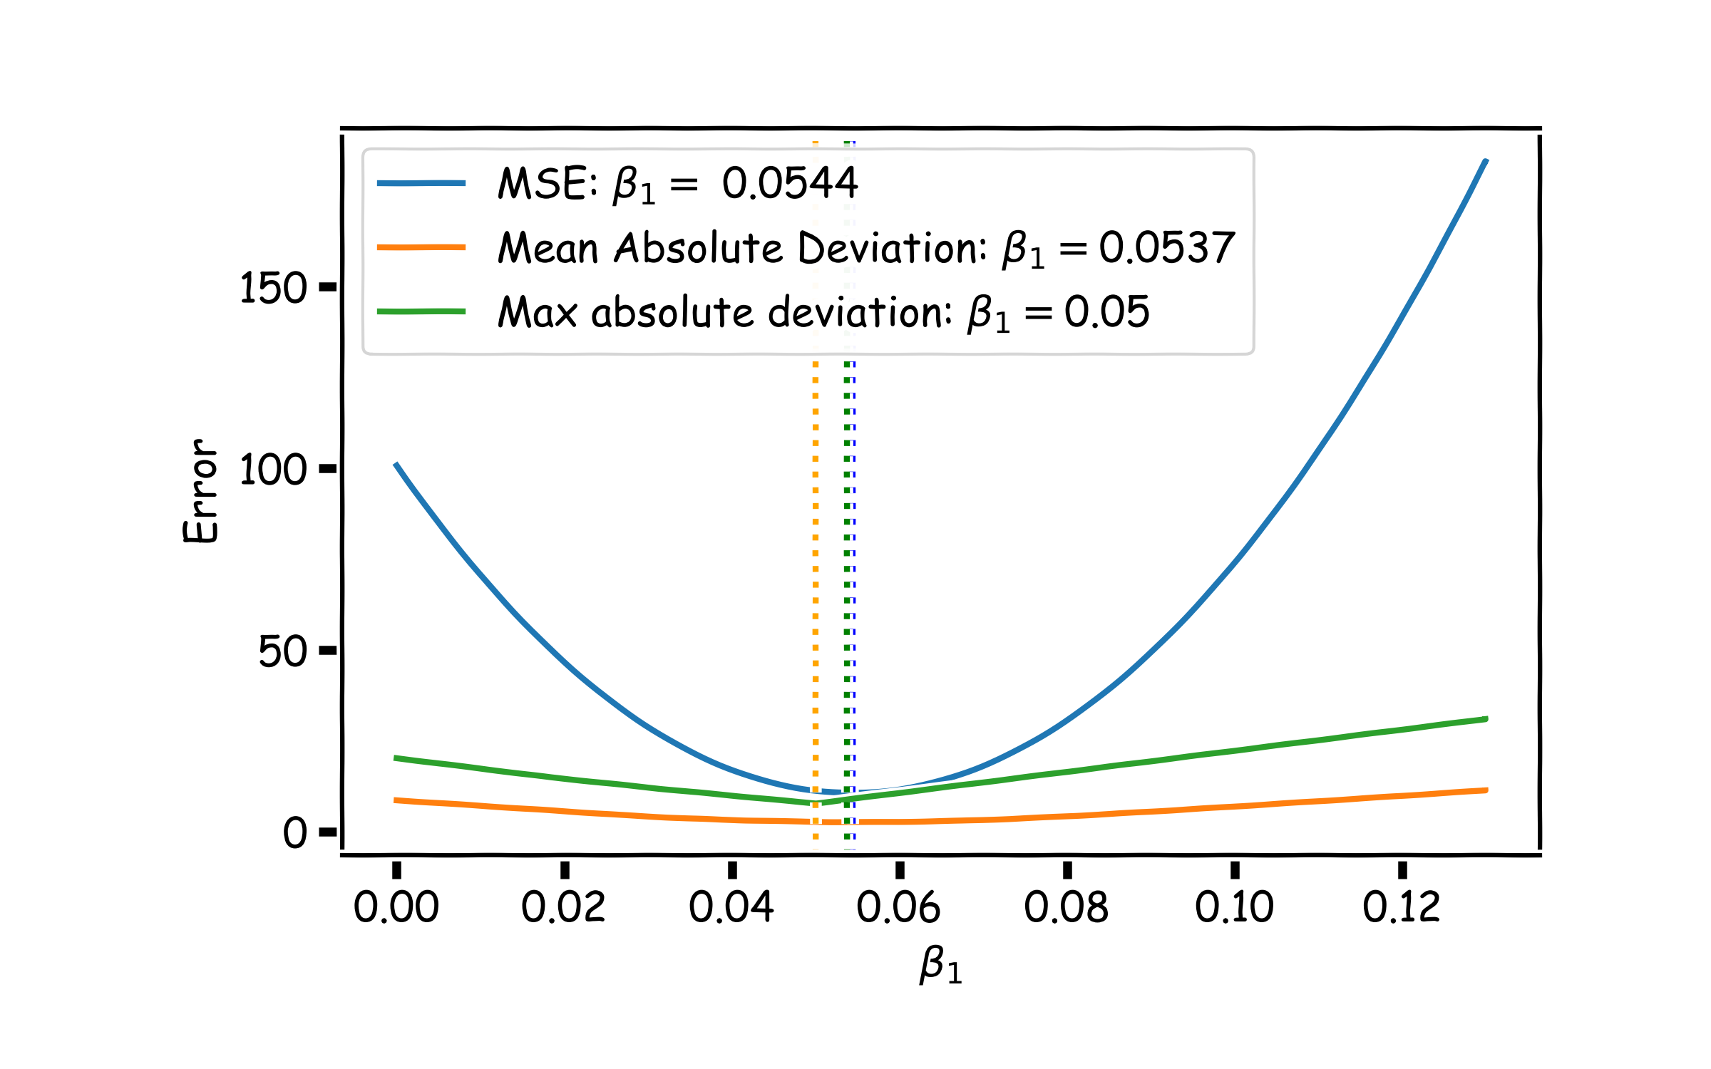
Loss Functions Revisited
Question: In what scenarios would you choose Mean Absolute Deviation or Max Absolute Deviation over MSE?
Notes:
Max: Think of credit data, when we want to eliminate outliers. Mean when you look for profit and opportunity cost – think real estate

Slide 60
Things to Consider
Comparison of Two Models
How do we choose from two different models?
Model Fitness
How does the model perform predicting?
Evaluating Significance of Predictors
Does the outcome depend on the predictors?
How well do we know $\hat{f}$
The confidence intervals of our $\hat{f}$

Slide 61
Evaluating Significance of Predictors

Slide 62
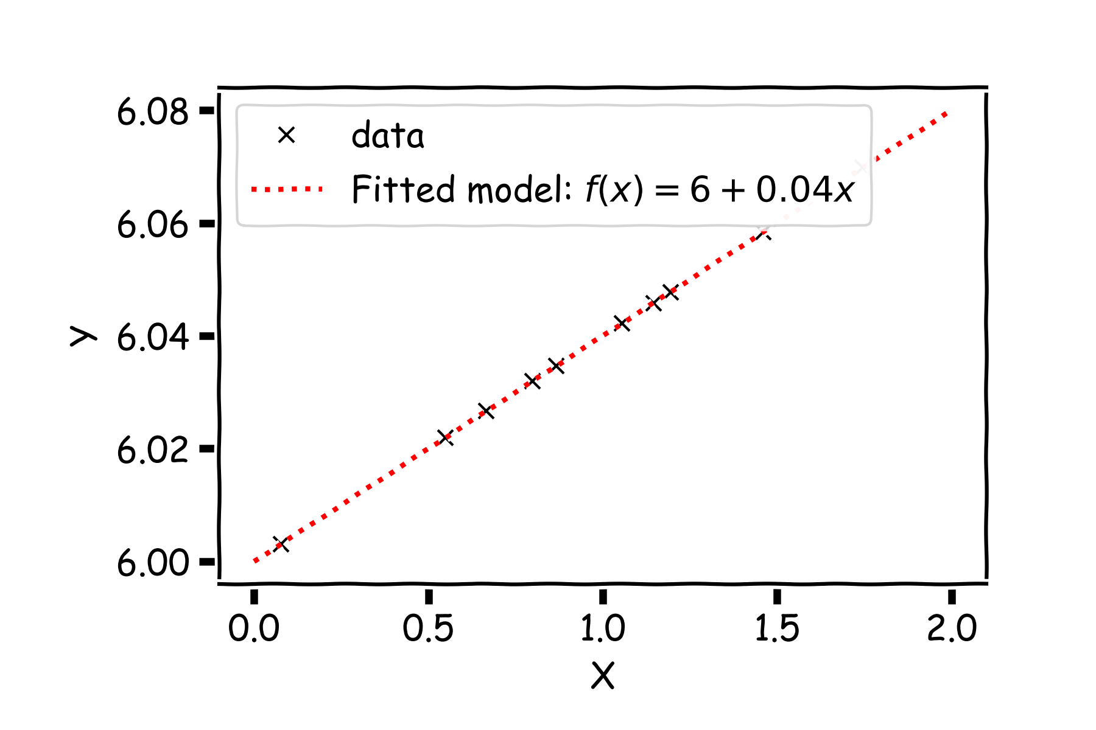
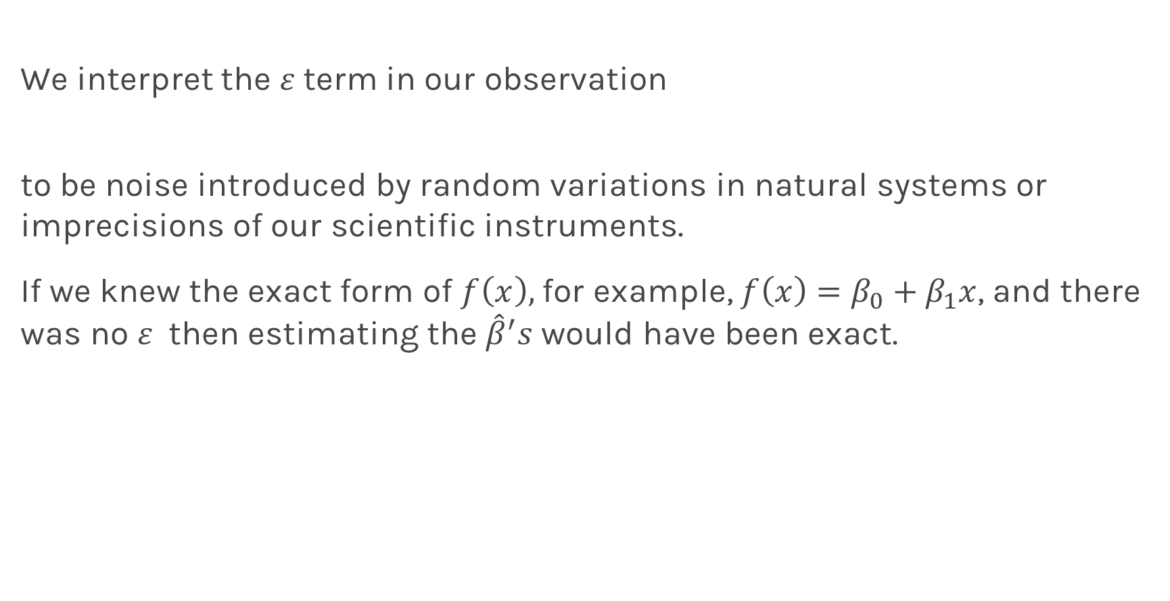
Evaluating Significance of Predictors
We interpret the $ε$term in our observation
to be noise introduced by random variations in natural systems or imprecisions of our scientific instruments.
If we knew the exact form of $f\left(x\right),$for example, $f\left(x\right)=β_{0}+β_{1}x$, and there was no $ε$ then estimating the ${\hat{β}}^{′}s$ would have been exact.
Notes:
Axes labels! (DLS)

Slide 63
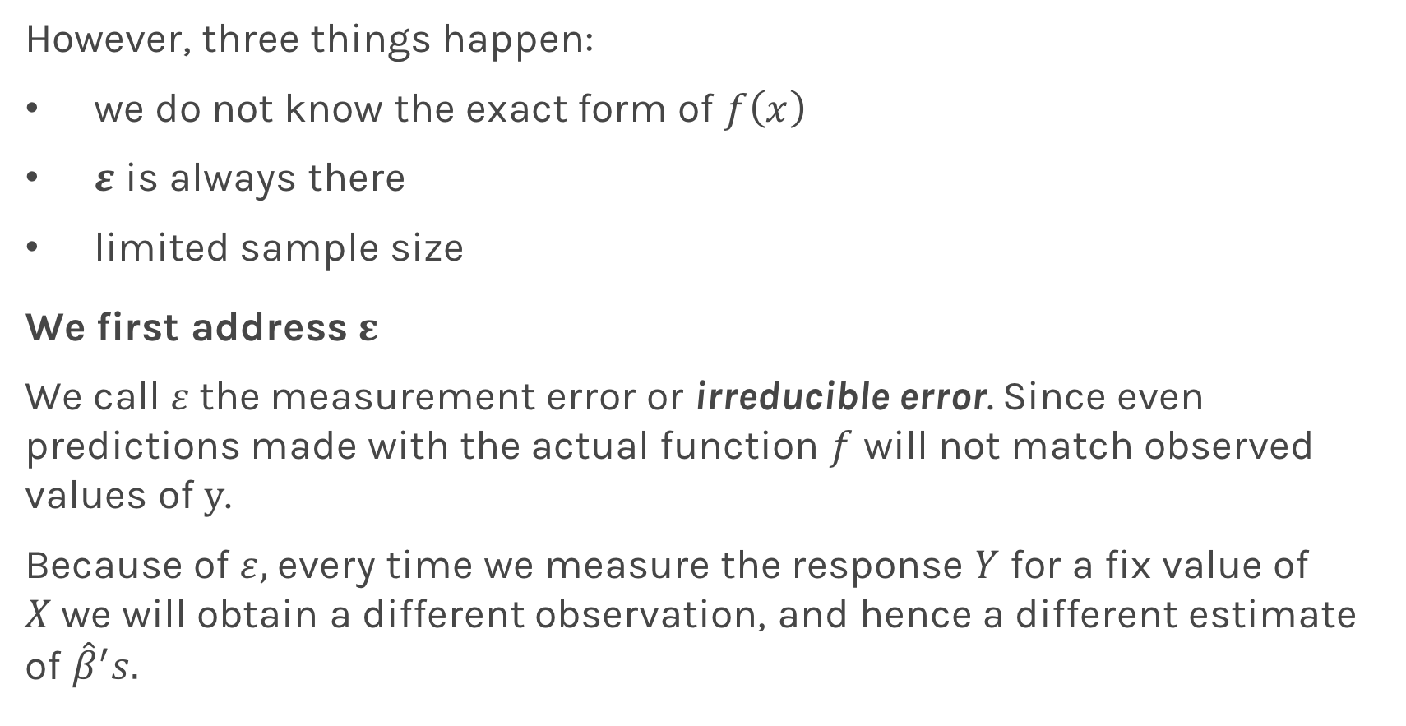
Evaluating Significance of Predictors
However, three things happen:
we do not know the exact form of $f\left(x\right)$
$ε$ is always there
limited sample size
We first address $ε$
We call $ε$the measurement error or irreducible error. Since even predictions made with the actual function $f$ will not match observed values of $y$.
Because of $ε,$ every time we measure the response $Y$ for a fix value of $X$we will obtain a different observation, and hence a different estimate of ${\hat{β}}^{′}s.$

Slide 64

Evaluating Significance of Predictors
Start with a model

Slide 65

Evaluating Significance of Predictors
For a some values of $X,$ $Y=f(X)$

Slide 66

Evaluating Significance of Predictors
But due to error, every time we measure the response Y for a fixed value of X we will obtain a different observation.

Slide 67

Evaluating Significance of Predictors
One set of observations, ‘one realization’, means one set of Ys (red crosses).

Slide 68

Evaluating Significance of Predictors
Another set of observations, ‘another realization’ means another set of Ys (green crosses).

Slide 69

Evaluating Significance of Predictors
Another set of observations, ‘another realization’ means another set of Ys (black crosses).

Slide 70


Evaluating Significance of Predictors
For each one of those ‘realizations’, we could fit a model and estimate, ${\hat{β}}_{0}$ and ${\hat{β}}_{1}.$

Slide 71

Evaluating Significance of Predictors
For each one of those ‘realizations’, we could fit a model and estimate, ${\hat{β}}_{0}$ and ${\hat{β}}_{1}.$

Slide 72

Evaluating Significance of Predictors
For each one of those ‘realizations’, we could fit a model and estimate, ${\hat{β}}_{0}$ and ${\hat{β}}_{1}.$

Slide 73

Evaluating Significance of Predictors
$$.$$
Repeat this on real data. We now select a sub-sample from all the data.

Slide 74

Evaluating Significance of Predictors
Another sub-sample.

Slide 75

Evaluating Significance of Predictors
Another sub-sample.

Slide 76

Evaluating Significance of Predictors
Another sub-sample.

Slide 77

Evaluating Significance of Predictors
Repeat this for 100 times.

Slide 78

Evaluating Significance of Predictors
We can estimate the mean and standard deviation of the estimate ${\hat{β}}_{1}$

Slide 79


Evaluating Significance of Predictors
We can calculate the confidence intervals, which are the ranges of values such that the true value of $β_{1}$is contained in this interval with c percent probability.
95%
68%

Slide 80



Now we can answer the question, “how significant are the predictors?” Here we show the same analysis for all three predictors.
Question: Which ones are important?

Slide 81



We examine how consistent the estimated values of the coefficients are with zero. Looking at the area under the curve below zero.
This is called hypothesis testing which we will visit again later.

Slide 82

Evaluating Significance of Predictors
However, three things happen:
we do not know the exact form of $f\left(x\right)$
$ε$ is always there
Sample size
We now address sample size
As we saw earlier, sample estimates are approximation to population means … blah blah … blah blah blah … statistics …
Let’s think how this affects our estimate of predictors and how this affects are conclusions on the significance of the predictors.
Notes:
Aleatoric error? (DLS)

Slide 83
Estimate Uncertainty for Coefficients
Once we have the distribution,

Slide 84
Estimate Uncertainty for Coefficients
Once we have the distribution, we can calculate the mean and variance.

Slide 85
Estimate Uncertainty for Coefficients
And then we calculate the confidence intervals and the importance of the predictors.

Slide 86
Sample size
Let’s re-examine this more carefully.
Notes:
[RD: ADD WHATEVER YOU WANT HERE ABOUT POPULATION VS SAMPLE]

Slide 87

Sample size
Let’s re-examine this more carefully.
In statistics, any estimate value is subject to sample size:
The estimated value, is called the sample mean
Whereas $E[x]$ is called the population mean
Notes:
[RD: ADD WHATEVER YOU WANT HERE ABOUT POPULATION VS SAMPLE]

Slide 88



TV | sales
230.1 | 22.1
44.5 | 10.4
17.2 | 9.3
151.5 | 18.5
180.8 | 12.9
8.7 | 7.2
57.5 | 11.8
120.2 | 13.2
8.6 | 4.8
199.8 | 10.6
66.1 | 8.6
214.7 | 17.4
23.8 | 9.2
97.5 | 9.7
204.1 | 19.0
195.4 | 22.4
67.8 | 12.5
281.4 | 24.4
69.2 | 11.3
147.3 | 14.6
Notes:
Here show how sub-sampling works ?

Slide 89



Larger the sample less variation in the prediction

Slide 90


How do $μ_{β}$ and $σ_{β}$ depend on $ε, \hat{f}$, and number of samples?
Assume we know the functional form of $f,$we examine the relationship to number of samples.

Slide 91

How do $μ_{β}$ and $σ_{β}$ depend on $ε, \hat{f}$, and number of samples?
Notes:
Show the sub-sample size

Slide 92

How do $μ_{β}$ and $σ_{β}$ depend on $ε, \hat{f}$, and number of samples?
We used sub-sample size 50 before
Notes:
Show the sub-sample size

Slide 93

How do $μ_{β}$ and $σ_{β}$ depend on $ε, \hat{f}$, and number of samples?
However, we should have used sub-sample size 200.
Notes:
Show the sub-sample size

Slide 94
Bootstrap

Slide 95
Bootstrap
Imagine we have 5 billiard balls in a bucket.

Slide 96
Bootstrap
We first pick randomly a ball and replicate it. This is called sampling with replacement.
We move the replicated ball to another bucket.

Slide 97
Bootstrap

Slide 98
Bootstrap
We then pick randomly another ball and again we replicate it.
Again, we then move the replicated ball to the other bucket.

Slide 99
Bootstrap

Slide 100
Bootstrap
We repeat this process.
Notes:
Fix this with true replacement

Slide 101
Bootstrap
Again

Slide 102
Bootstrap
And again

Slide 103
Bootstrap
Until the other bucket has the same number of balls as the original one.

Slide 104
Bootstrap
We repeat the same process and acquire another sample

Slide 105
Bootstrap
We repeat the same process and acquire another sample

Slide 106

Bootstrapping for Estimating Sampling Error
Definition
Bootstrapping is the practice of estimating properties of an estimator by measuring those properties by, for example, sampling from the observed data.
For example, we can compute ${\hat{β}}_{0}$ and ${\hat{β}}_{1}$multiple times by randomly sampling from our data set. We then use the variance of our multiple estimates to approximate the true variance of ${\hat{β}}_{0}$ and ${\hat{β}}_{1}$.

Slide 107

Standard Errors
The variance of $β_{0}$ and $β_{1}$ are also called their standard errors, $SE\left({\hat{β}}_{0}\right),SE\left({\hat{β}}_{1}\right).$
If our data is drawn from a larger set of observations then we can empirically estimate the standard errors, $SE\left({\hat{β}}_{0}\right),SE\left({\hat{β}}_{1}\right)$ of $β_{0}$ and $β_{1}$through bootstrapping.
If we know the variance $σ^{2}$ of the noise $ε$, we can compute $SE\left({\hat{β}}_{0}\right),SE\left({\hat{β}}_{1}\right)$ analytically, using the formulae below:
Notes:
If data set is small this approximation does not work

Slide 108

Standard Errors
In practice, we do not know the theoretical value of $σ$ since we do not know the exact distribution of the noise $ε$. However, if we make the following assumptions,
the errors $ε_{i}=y_{i}−{\hat{y}}_{i}$and $ε_{j}=y_{j}−{\hat{y}}_{j}$ are uncorrelated, for $i≠j$ ,
each $ε_{i}$ is normally distributed with mean 0 and variance $σ^{2}$,
then, we can empirically estimate $σ^{2}$, from the data and our regression line:

Slide 109

Standard Errors
Exercise: Duplicate the following results for the coefficients for TV advertising.
Method | $$SE\left({\hat{β}}_{0}\right)$$ | $$SE\left({\hat{β}}_{1}\right)$$
Analytic Formula | 0.353 | 0.0023
Bootstrap | 0.328 | 0.0028

Slide 110

Importance of predictors
We have discussed finding the importance of predictors, by determining the cumulative distribution from $∞$ to 0.
.

Slide 111


Importance of predictors
This is equivalent in looking the distance of the estimated value of the coefficient in units of SE(${\hat{β}}_{1}$) = $σ_{{\hat{β}}_{1}}$.
.
$$μ_{{\hat{β}}_{1}}−0$$
$$σ_{{\hat{β}}_{1}}$$

Slide 112

Hypothesis Testing
Hypothesis testing is a formal process through which we evaluate the validity of a statistical hypothesis by considering evidence for or against the hypothesis gathered by random sampling of the data.
State the hypotheses, typically a null hypothesis, $H_{0}$ and an alternative hypothesis, $H_{1}$, that is the negation of the former.
Choose a type of analysis, i.e. how to use sample data to evaluate the null hypothesis. Typically this involves choosing a single test statistic.
Sample data and compute the test statistic.
Use the value of the test statistic to either reject or not reject the null hypothesis.

Slide 113
Hypothesis testing
1. State Hypothesis:
Null hypothesis:
$H_{0}$: There is no relation between X and Y
The alternative:
$H_{a}$: There is some relation between X and Y
2: Choose test statistics
To test the null hypothesis, we need to determine whether, our estimate for ${\hat{β}}_{1}$, is sufficiently far from zero that we can be confident that ${\hat{β}}_{1}$ is non-zero. We use the following test statistic:

Slide 114

Hypothesis testing
3. Sample:
Using bootstrap we can estimate ${\hat{β}}_{1}.$
4. Reject or not reject the hypothesis:
If there is really no relationship between X and Y , then we expect that will have a t-distribution with n-2 degrees of freedom.
To compute the probability of observing any value equal to $|t|$ or larger, assuming ${\hat{β}}_{1}=0$ is easy. We call this probability the p-value.
a small p-value indicates that it is unlikely to observe such a substantial association between the predictor and the response due to chance

Slide 115


Hypothesis testing
P-values for all three predictors done independently
Method | $$SE\left({\hat{β}}_{0}\right)$$ | $$SE\left({\hat{β}}_{1}\right)$$
Analytic Formula | 0.353 | 0.0023
Bootstrap | 0.328 | 0.0028
Method | $$SE\left({\hat{β}}_{0}\right)$$ | $$SE\left({\hat{β}}_{1}\right)$$
Analytic Formula | 0.353 | 0.0023
Bootstrap | 0.328 | 0.0028
Method | $$SE\left({\hat{β}}_{0}\right)$$ | $$SE\left({\hat{β}}_{1}\right)$$
Analytic Formula | 0.353 | 0.0023
Bootstrap | 0.328 | 0.0028

Slide 116
Things to Consider
Comparison of Two Models
How do we choose from two different models?
Model Fitness
How does the model perform predicting?
Evaluating Significance of Predictors
Does the outcome depend on the predictors?
How well do we know $\hat{f}$
The confidence intervals of our $\hat{f}$

Slide 117

How well do we know $\hat{f}$?
Our confidence in $f$ is directly connected with the confidence in $β$s. So for each $β$ we can make a prediction.

Slide 118

How well do we know $\hat{f}$?
Here we show two difference set of predictions given the fitted coefficioents for a given subsample

Slide 119

How well do we know $\hat{f}$?
There is one such regression line for every imaginable sub-sample.

Slide 120


How well do we know $\hat{f}$?
Below we show all regression lines for a thousand of such sub-samples.
For a given $x$, we examine the distribution of $\hat{y}$, and determine the mean and standard deviation.

Slide 121

How well do we know $\hat{f}$?
Below we show all regression lines for a thousand of such sub-samples.
For a given $x$, we examine the distribution of $\hat{y}$, and determine the mean and standard deviation.

Slide 122

How well do we know $\hat{f}$?
Below we show all regression lines for a thousand of such sub-samples.
For a given $x$, we examine the distribution of $\hat{y}$, and determine the mean and standard deviation.

Slide 123

How well do we know $\hat{f}$?
For every $x$, we calculate the mean of the predictions, $\hat{y}$ (shown with dotted line) and the 95% CI of those predictions (shaded area).

